Slide 1
Introduction to C
Programming Workshop in C (67316)
Fall 2017
Lecture 1
24.10.2017

Slide 2

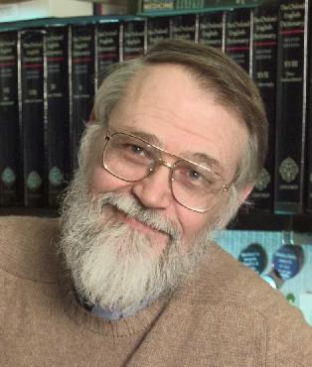
History
He has said that if stranded on an island with only one programming language it would have to be C
C
C++
Java
70’s – Development of UNIX.
(Ritchie & Kernighan – AT&T Bell)
80’s – Large efficient code.
(Stroustrup – Bell)
90’s – Language for the web (Sun Microsystems)
Simple to convert to
machine code
VM as a middle layer
Fast and Efficient
Secure and Safe
Low level coding
High level coding

Slide 3

C – 32 Keywords only

Slide 4
History – C:
First "standard”
Default int
enums
return struct
fun. prototypes
void
single line comments //
VLA
Variadic macros
inline
multithreading
Anonymous structs
_Generic
ANSI C
C89
C90
('89)
invented
(‘72)
Ritchie 1st ed. ('78)
C99
('99)
C11
('11)
This course

Slide 5
C – Design Decisions
Efficient & Simple
Deals with objects that computers do (e.g.: ints, no lists)
Tightly controls memory & CPU usage
Can understand & use ENTIRE language
Type checking
But: “Programmers know what they are doing”
Portable (OS, HW) code
Standard language definition
Standard library

Slide 6
C – Design Decisions
Disadvantages
May be time-consuming and error-prone to code some tasks (e.g. home-made text parsing)
Low level coding means it’s easier to make fatal mistakes (e.g. invalid memory pointers)

Slide 7
C – What is it used for?
Systems programming
Operating systems, such as Linux
microcontrollers: cars & planes
embedded processors: phones, portable electronics
DSP processors: digital audio & TV systems
where there are tight limits on memory and CPU time

Slide 8

C – beware:
No run-time checks
Array boundary overruns
Illegal pointers
No memory management
Programmer has to manage memory
Get memory from OS
Release it when done using it
Note: You can work in C without dealing with memory, like we will do in the beginning of our course

Slide 9
C++ - OO extension of C
Classes & methods
OO design of classes
(More) Generic programming
Templates allow for code reuse
Stricter type system
Some run-time checks & memory control

Slide 10
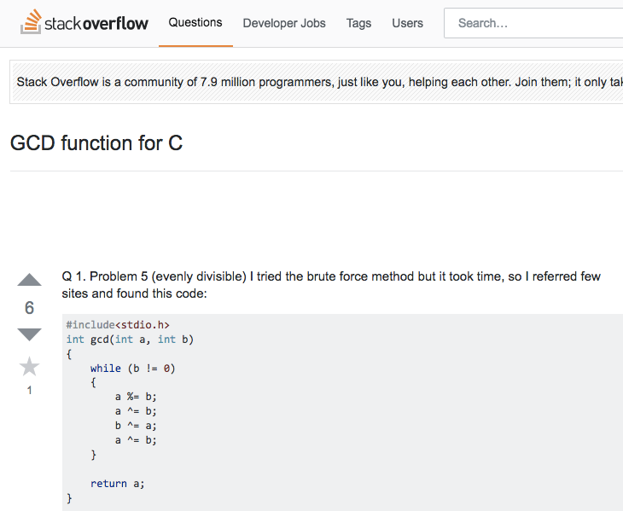
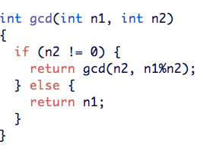
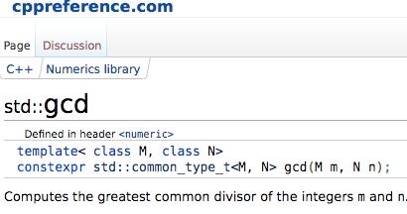
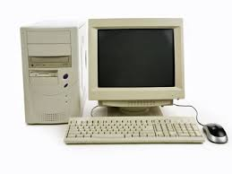
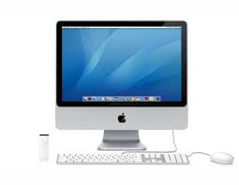
The evolution of coding
Last century
This century
code your function
google it

Slide 11

The evolution of coding
The programs are constantly growing
We need to learn how to read code (not only write!)
Debugging is a big part of coding
Year | Version | Source lines of code (millions)
2001 | Linux kernel 2.4.2 | 2.4
2003 | Linux kernel 2.6.0 | 5.2
2009 | Linux kernel 2.6.29 | 11.0
2009 | Linux kernel 2.6.32 | 12.6
2010 | Linux kernel 2.6.35 | 13.5
2012 | Linux kernel 3.6 | 15.9
2015 | Linux kernel pre-4.2 | 20.2
https://en.wikipedia.org/wiki/Source_lines_of_code

Slide 12
Hello World!

Slide 13
First Program in C
// This line is a comment,
/* and those lines also.
Next line includes standard I/O header file */
#include <stdio.h> //part of the C Standard Library
// main function – program entry point. // Execution starts here
int main()
{ // {…} define a block
printf("Hello class!\n");
return 0;
}
Note:
Coding guidelines are online. The slides are not a reference for coding style.
13

Slide 14
Compiling & Running…
> gcc hello.c
> a.out
Hello class!
> gcc –std=c99 –Wall hello.c –o hello
> hello
Hello class!
enable most compiler warning
set program output file name
use c99 standard
14

Slide 15
Debugging
> gcc -g –Wall hello.c –o hello
> hello
Hello class!
> gdb hello
Some useful commands:
break linenumber – create breakpoint at specified line
break file:linenumber – create breakpoint at line in file
run – run program
c – continue execution
next – execute next line
step – execute next line or step into function
quit – quit gdb
print expression – print current value of the specified expression
help command – in-program help
add -g option to enable debugging
15

Slide 16
Why coding style matters?
Coding style is how your code looks
Coding style is personal
CamelCase: aRatherLongSymbolName
snake_case: a_rather_long_symbol_name
Big projects require standards for coding style
These conventions usually include file organization, indentation, comments, declarations, statements, white space, naming conventions, programming practices...
Coding style guides are an important part of writing code as a professional

Slide 17
Variables

Slide 18
Variables
Statically typed – each variable has a type which is known at compile time Declare by: <type> <name>
int x; int x,y;
int x=0;
Optionally initialize (otherwise, for local variables, it is undefined!)
Important word in C. Arbitrary initial value (=garbage) can be very confusing to debug

Slide 19
Numeric data types in C
char c = ‘A’;
short s = 0;
int x = 1;
long y = 9;
float x = 0.0;
double y = 1.0;
unsigned char c = ‘A’;
unsigned short s = 0;
unsigned int x = 1;
unsigned long y = 9;
// more on initialization
char a = ‘A’, b = ‘B’;
int x = y = 1; // equivalent to int x = (y = 1);

Slide 20
Defining new variables
Program memory
end
0
1
2
3
4
5
6
7

Slide 21
Defining new variables
Program memory
...
int x = 0;
x
0 | 0 | 0 | 0 | 0 | 0 | 0 | 0
0
1
2
3
4
5
6
7
end

Slide 22
Defining new variables
Program memory
...
int x = 0;
int y = 9;
0 | 0 | 0 | 0 | 0 | 0 | 0 | 0
0 | 0 | 0 | 0 | 1 | 0 | 0 | 1
0
1
2
3
4
5
6
7
y
end

Slide 23
Reading and setting variables
Program memory
...
int x = 0;
int y = 9;
x = y + 1;
x
0 | 0 | 0 | 0 | 1 | 0 | 1 | 0
0 | 0 | 0 | 0 | 1 | 0 | 0 | 1
0
1
2
3
4
5
6
7
end

Slide 24
Beware of overflow
...
unsigned char x = 0;
x = x - 1; // x = 255

Slide 25
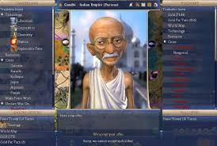
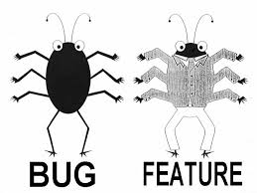
Fun fact - Gandhi and Civilization game
In the Civilization India’s supposedly-peaceful leader Gandhi has been famous for dropping nukes
Each leader in the game had an “aggression” score
Gandhi had the lowest score of 1
When a player adopted democracy in Civilization, their aggression would be automatically reduced by 2
http://kotaku.com/

Slide 26
Primitive types and sizeof operator
// Queries size of the object or type
unsigned long numberOfBytes =
sizeof(unsigned char);
The individual sizes are machine/compiler dependent.
The following is guaranteed:
sizeof(char)<sizeof(short)<=sizeof(int)<=sizeof(long)
and
sizeof(char)<sizeof(short)<=sizeof(float)<=sizeof(double)

Slide 27

What are the sizes of standard variables?
/* A program that prints variable sizes */
#include <stdio.h>
int main()
{
// Basic primitive types:
printf("Size of char %lu\n", sizeof(char));
printf("Size of short %lu\n", sizeof(short));
printf("Size of int %lu\n", sizeof(int));
printf("Size of long %lu\n", sizeof(long));
printf("Size of float %lu\n", sizeof(float));
printf("Size of double %lu\n", sizeof(double));
// Other types: printf(“Size of long double %lu\n",sizeof(long double));
return 0;
}
l - is a length modifier meaning "long”
u - is a specifier meaning "unsigned decimal integer”
see printf Documentation for more options

Slide 28
Variables
Where to declare?
Inside a block (C89 - block beginning), visible only in block
Outside all blocks – global - will be visible everywhere
int x=0; // global int main()
{ int x=1; //local hides global
{ int x=2; //local hides outer scope //x is 2 } //x is 1 again! }

Slide 29
Scopes
Code block defined with “{” and “}”
Nesting is possible
Only declarations inside current or outer scopes are visible
Declarations in inner scope hide declarations in outer scopes
Outmost scope (global) has no brackets
Keep in mind that a function is also a scope

Slide 30
Scopes
int y=5,x=0; { int x=y; // x is 5 { int y=0; // x is ? } } // x is ?

Slide 31
Scopes
int y=5,x=0; { int x=y; // x is 5 { int y=0; // x is 5 } } // x is 0

Slide 32
Operators

Slide 33
Operator Types in C
Arithmetic operators: + - * / %
Increment and decrement operators ++ --
Relational operators: < <= > >= == !=
Logical operators: && || !
Bitwise operators: & | ^ << >> -
Assignment operators: += -= *= /= %= ...
can be binary (such as + ), unary (such as ++), or ternary

Slide 34
Arithmetic operators
The order of evaluation is as in algebraic expressions:
brackets first, followed by * and /, followed by +
from left to right
Operator | Meaning | Examples
+ | addition | int x = y + 3;
- | subtraction | int x = y - 3;
* | multiplication | float z = x * y;
/ | division | float x = 3 / 2; // = 1 float y = 3.0 / 2; // = 1.5 int z = 3.0 / 2; // = 1
% | remainder | int x = 3 % 2;

Slide 35
Increment and decrement operators
++ and -- operators are shortcuts:
x++; | x = x + 1;
y = x++; | y = x; x = x + 1; | x is evaluated before it is increment
y = ++x; | x = x + 1; y = x; | x is evaluated after it is incremented

